Slide 1
Revelation 15

Slide 2
Revelation 15
Characteristics of God
Faithful saints will overcome evil
God’s ways are just
God’s ways are true
Ultimately, evil will fear God
Only God is holy

Slide 3
Revelation 15:2-3 - Song of Moses
² And I saw as it were a sea of glass mingled with fire: and them that had gotten the victory over the beast, and over his image, and over his mark, and over the number of his name, stand on the sea of glass, having the harps of God.
³ And they sing the song of Moses the servant of God, and the song of the Lamb, saying, Great and marvelous are thy works, Lord God Almighty; just and true are thy ways, thou King of saints.

Slide 4
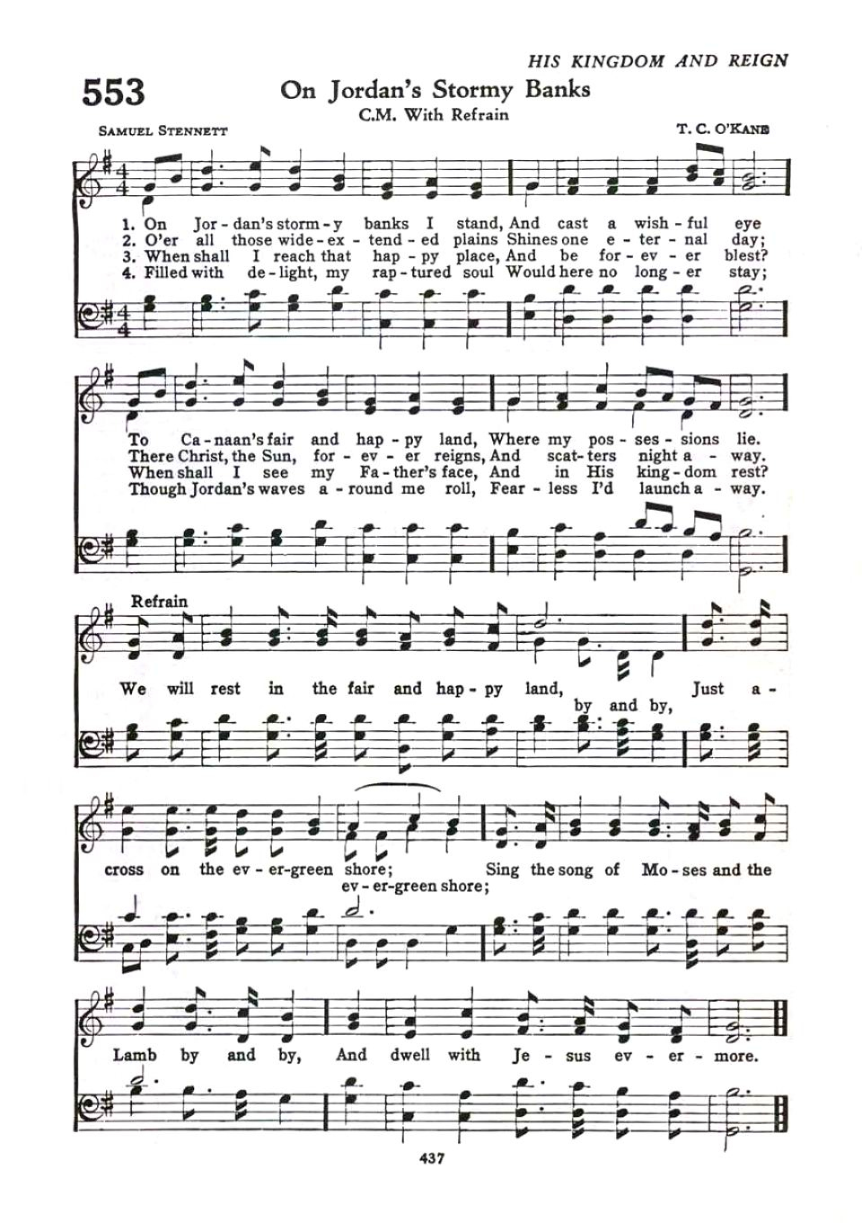
Revelation 15:3 - Song of Moses
Notes:
Angels are singing those songs, now.
We anticipate singing them as well.
Song of Moses & Song of the Lamb mentioned together, just like in Revelation.

Slide 5
Revelation 15: Song of Moses (1)
Exodus 15
¹ Then Moses and the Israelites sang this song to the LORD: “I will sing to the LORD, for He is highly exalted. The horse and rider He has thrown into the sea.
⁶ Your right hand, O LORD, is majestic in power; Your right hand, O LORD, has shattered the enemy.
¹¹ Who among the gods is like You, O LORD? Who is like You—majestic in holiness, revered with praises, performing wonders?
¹³ With loving devotion You will lead the people You have redeemed; with Your strength You will guide them to Your holy dwelling.
¹⁸ The LORD will reign forever and ever!”
Notes:
2 places traditionally referred to as the “Song of Moses”
Song at the Sea
Revelation reflects these characteristics of God.

Slide 6
Revelation 15: Song of Moses (2)
Deuteronomy 32
(God redeems and judges)
⁴⁵ When Moses had finished reciting all these words to all Israel,
⁴⁶ he said to them, “Take to heart all these words I testify among you today, so that you may command your children to carefully follow all the words of this law.
⁴⁷ For they are not idle words to you, because they are your life, and by them you will live long in the land that you are crossing the Jordan to possess.”
Notes:
Concepts of both chapters are reflected in Revelation as well.
Song of the Lamb
Could be the praise we have heard all through the book of Revelation.
Restates the characteristics of the Lamb of God listed in Revelation, especially chapter 5
Since Jesus Christ is the same yesterday, today, and forever, it stands to reason that the words spoken in the book of Revelation as praise to God the Father and God the Son would at least be a part of the Song of the Lamb.
Or, is it a new song that we will learn in Heaven?

Slide 7
Revelation 15: Song of the Lamb
³ And they sing the song of Moses the servant of God, and the song of the Lamb, saying, Great and marvelous are thy works, Lord God Almighty; just and true are thy ways, thou King of saints.
⁴ Who shall not fear thee, O Lord, and glorify thy name? for thou only are holy: for all nations shall come and worship before thee; for thy judgments are made manifest.
What is the specific purpose of this judgment?
Judgment against evil which occurs in chapter 16 . . .
. . . beginning with . . .
⁷ And one of the four beasts gave unto the seven angels seven golden vials [bowls] full of the wrath of God, who lives for ever and ever.
Notes:
“Song of Moses” – song of deliverance
“Song of Lamb” – one of praise and recognition of this holiness and judgment
Much of conversations of Angels in the book of Revelation is a direct response to judgment against evil, most notably, the villain of Revelation.
What judgment? We are told specifically in Chapter 16.
“vial” – GR word means a shallow or flat bowl. Used 12x in Revelation. KJV always translates that word as a “vial”. NKJV and NAS translate the word as “bowl”.
KJV = “vial” or “small container”.
Here we go . . . God’s wrathful judgment is prepared

